Slide 1
EAS 509 – Group18 Abhinav Nehra Kumar Utkarsh Gaurav Kumar Jha
Sector-wise Stock Price Segmentation and Forecasting to uncover Investment Opportunities

Slide 2
Introduction
Motivation: Understanding and predicting stock market trends within specific industry sectors is crucial for investors and analysts to identify potential investment opportunities, optimize portfolio strategies, and mitigate risks eventually. With the help of this project we aim to leverage different data mining, statistical analysis and machine learning techniques learned in class to analyse historical stock price data, segment stocks within industry sectors using possible clustering algorithms like K-means, analyse feature importance using random forest/boosting and forecast future price trends using Time Series models.
Significance: By uncovering market segmentation, trend identification, and investment opportunities within each sector, this project will provide valuable insights and actionable recommendations for stakeholders in the financial markets

Slide 3
Methods
Data Preprocessing: Converted Date column, handled missing values, and scaled features
Exploratory Data Analysis: Visualized stock prices over time and checked summary statistics
Clustering(K-means): Applied K-means clustering to segment stocks within industry sectors and identify the industry sectors which have the highest dominating importance in each cluster
Feature Importance Analysis: Analyzed the important features that are impacting more towards the analysis using XGBoost
Time Series Forecasting(ARIMA): Forecasting future stock prices using the ARIMA model.
Link to Data Source: World Stock Prices (Daily Updating) Dataset

Slide 4
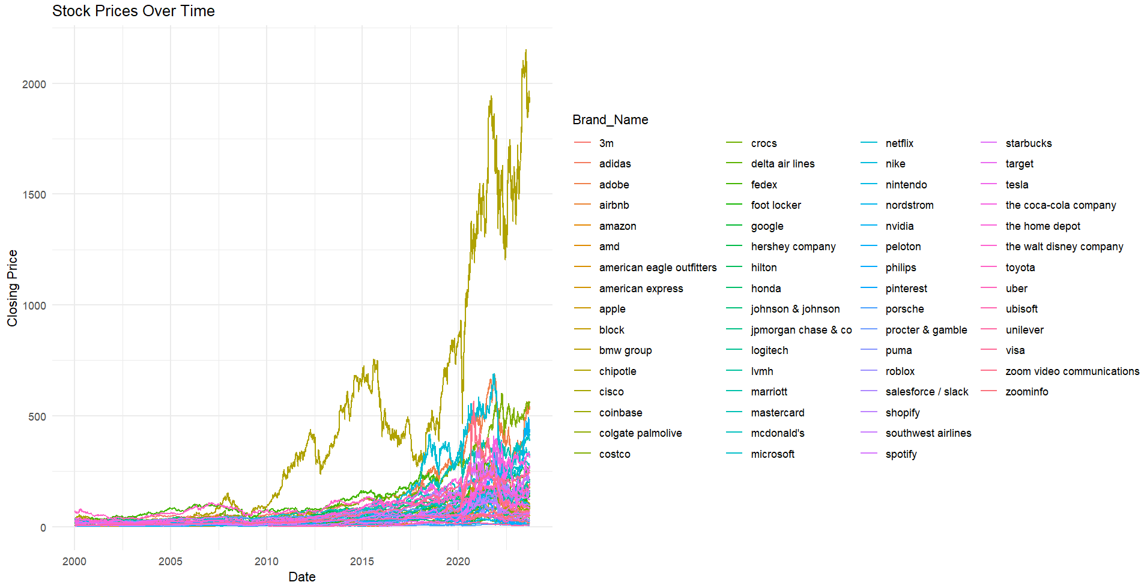
Results & Discussions
Based on analysing the stock prices overtime, it seems like technology companies like
Apple, cisco, block, coinbase etc. have the highest stock prices.
After analysing the obtained plot, it seems like technologies companies like apple, cisco, bmw etc. have the highest stock prices, followed by others with companies like zoom having the lowest which further suggests that there is a scope for industry/sectorwise segrmentation as proposed in our project title.

Slide 5
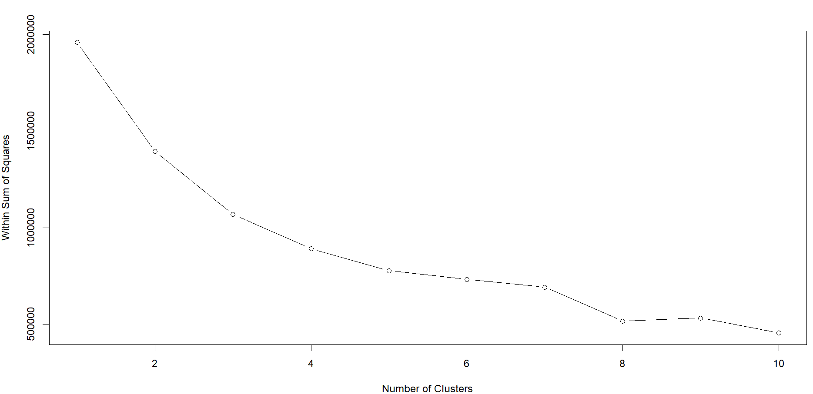
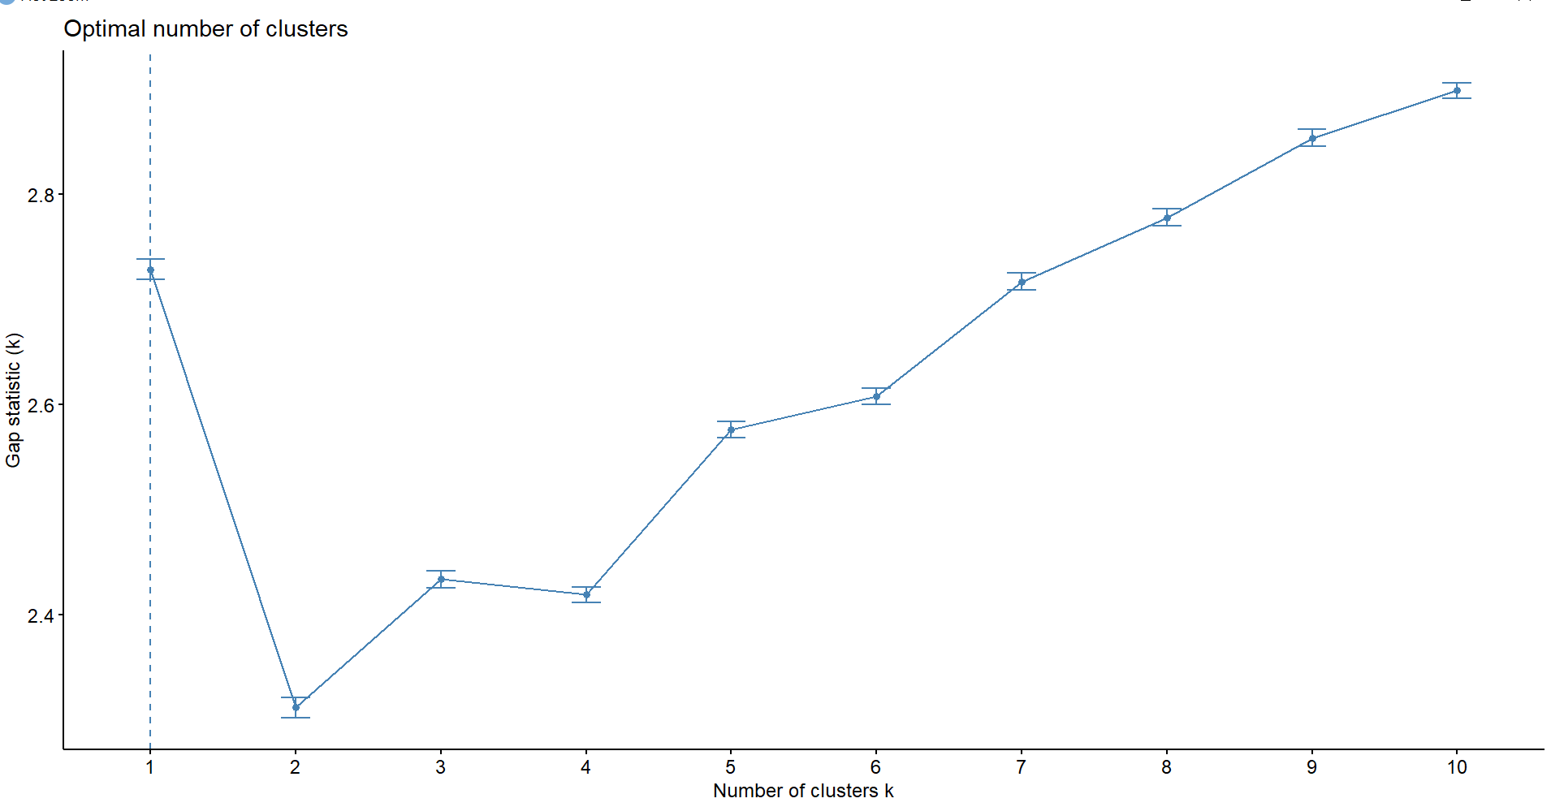
Elbow vs Gap Statistic method
Based on the elbow plot and gap statistic plot obtained, we decided to segment our processed and scaled data into 5 clusters for better interpretation and segmentation

Slide 6
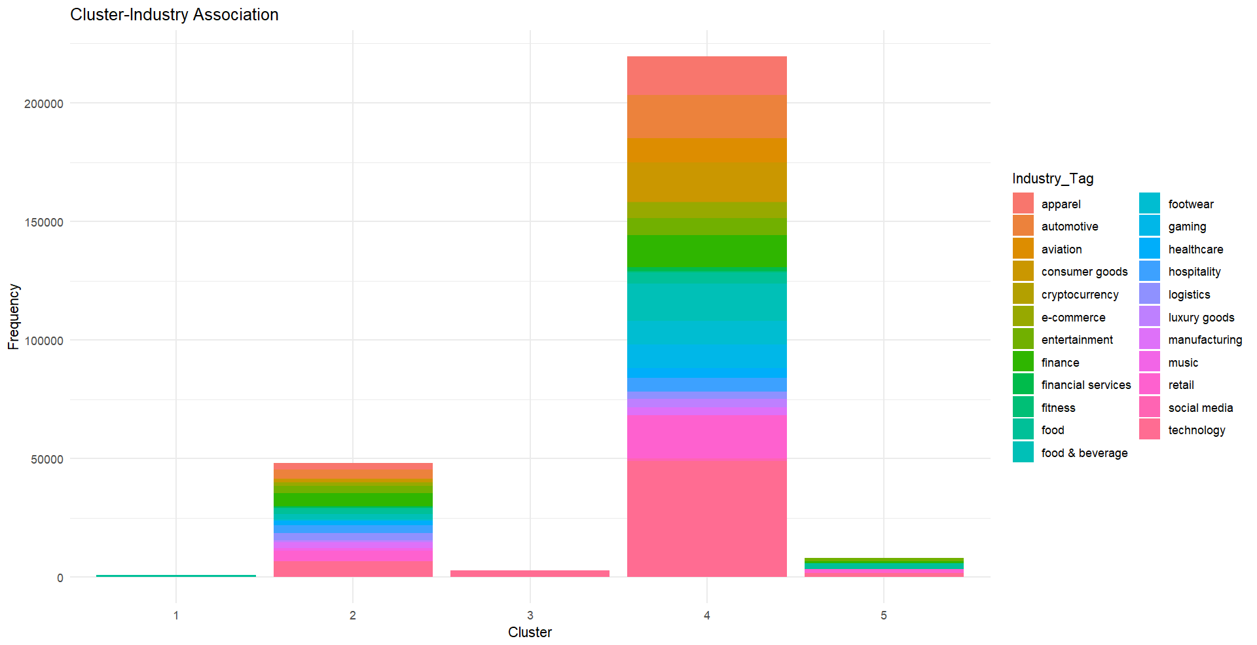
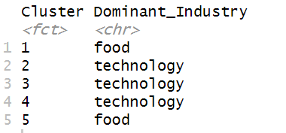
The below plots highlights the dominant industry prevalent in each cluster(cluster-wise segmentation of each industry)

Slide 7
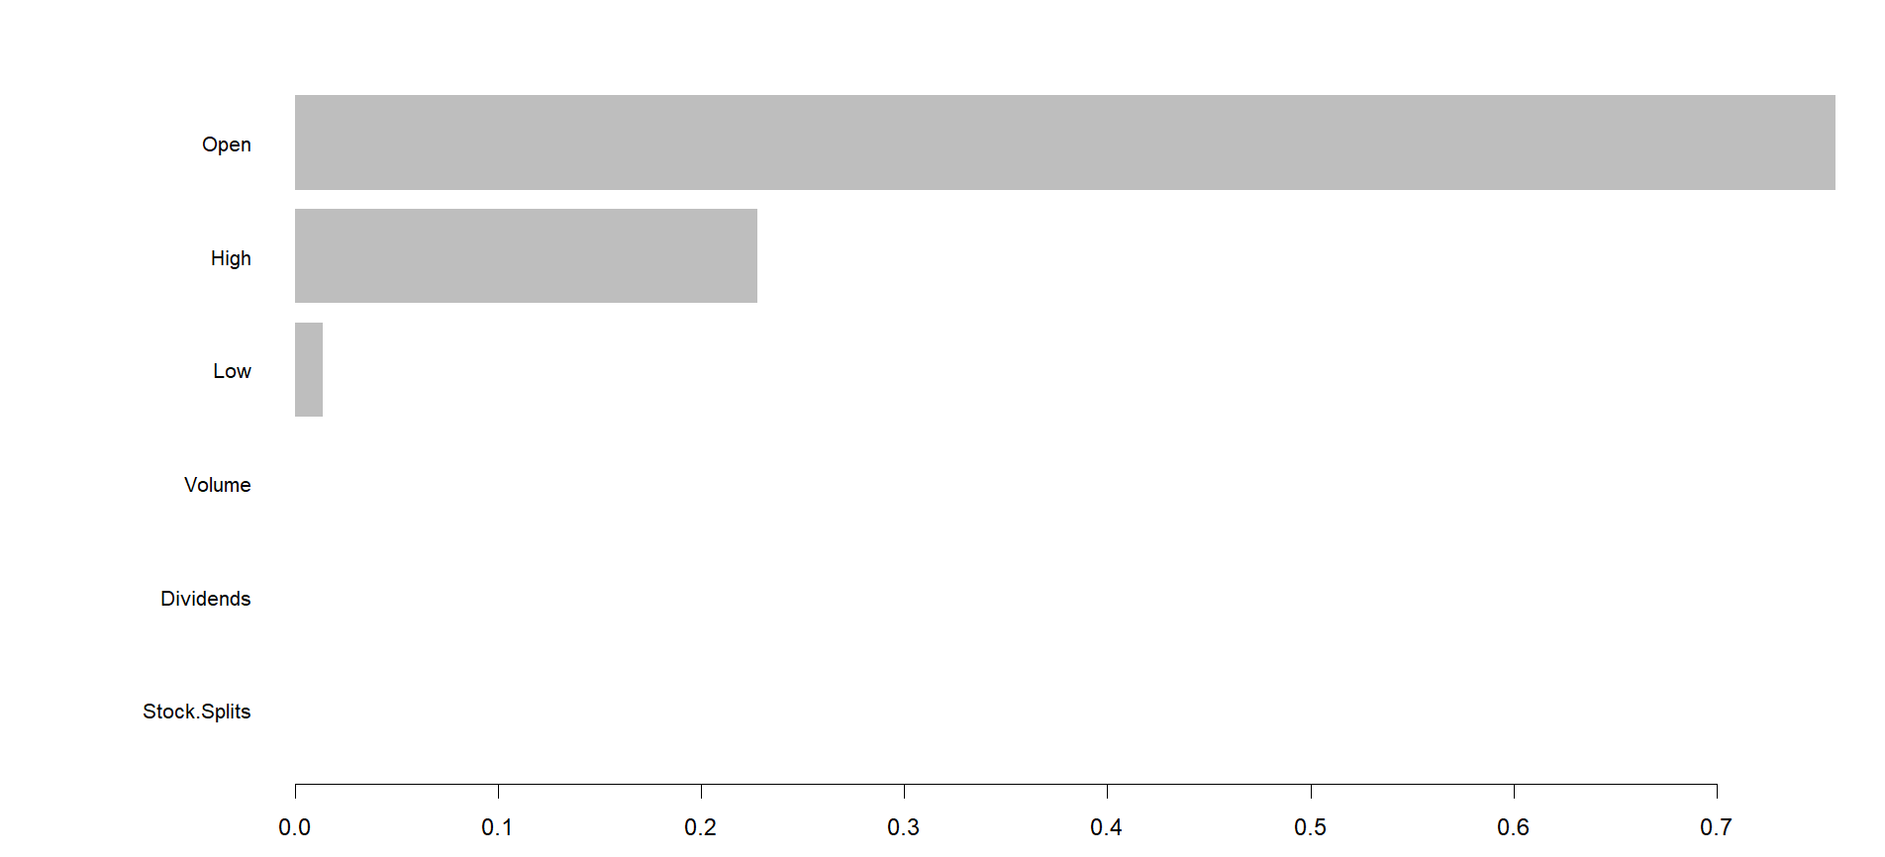
Feature Importance Analysis
We used XGBoost to analyse features importance as to what feature are contributing the most towards the analysis and as per the plot you can see that the open, high and low values of each stock seem to have a high emphasis on the analysis

Slide 8
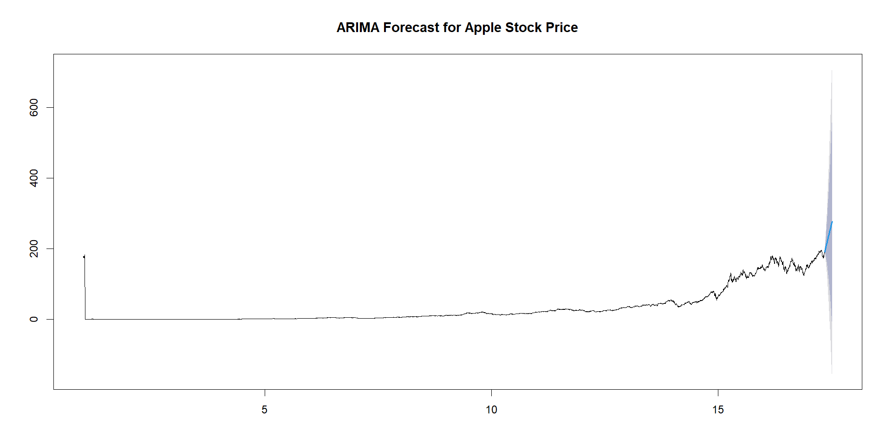
Forecasting future price trends using ARIMA
After clustering our data into different industry segments and identifying the most dominant one, we are using the ARIMA model here to predict the price for next 60 days for ‘Apple’

Slide 9
Conclusion
By leveraging data mining, statistical analysis, and machine learning techniques to analyze historical stock price data, we are able to segment the stocks within industry sectors, analyze feature importance, and forecast future price trends as well.
Based on the analysis provided, Investors can tailor their investment strategies based on the dominant industries within each cluster. For example, cluster 1 and 5, dominated by food-related companies, may appeal more to investors seeking stable and defensive investments, while clusters 2, 3, and 4, with a focus on technology, may attract investors interested in growth-oriented opportunities.

